Slide 1

COMPUTER NETWORKS
Animesh Giri
Department of Computer Science & Engineering

Slide 2

COMPUTER NETWORKS
Transport Layer
Animesh Giri
Department of Computer Science & Engineering

Slide 3

COMPUTER NETWORKS
TCP Congestion Control
Animesh Giri
Department of Computer Science & Engineering

Slide 4
In this segment
COMPUTER NETWORKS
TCP congestion control: additive increase multiplicative decrease
TCP Congestion Control: details
TCP Slow Start
TCP: detecting, reacting to loss
TCP: switching from slow start to CA
Summary: TCP Congestion Control
TCP throughput
TCP Futures: TCP over “long, fat pipes”
TCP Fairness
Why is TCP fair?
Explicit Congestion Notification (ECN)

Slide 5
COMPUTER NETWORKS
TCP congestion control: additive increase multiplicative decrease
approach: sender increases transmission rate (window size), probing for usable bandwidth, until loss occurs
additive increase: increase cwnd by 1 MSS every RTT until loss detected
multiplicative decrease: cut cwnd in half after loss
additively increase window size …
…. until loss occurs (then cut window in half)
AIMD saw tooth
behavior: probing
for bandwidth
cwnd: TCP sender
congestion window size
time

Slide 6
COMPUTER NETWORKS
TCP Congestion Control: details
sender sequence number space
TCP sending rate:
roughly: send cwnd bytes, wait RTT for ACKS, then send more bytes
cwnd
last byte
ACKed
last byte sent
sent, not-yet ACKed
(“in-flight”)
rate
cwnd
sender limits transmission:
cwnd is dynamic, function of perceived network congestion
~
bytes/sec
~
RTT
LastByteSent-
LastByteAcked
cwnd
<

Slide 7

COMPUTER NETWORKS
TCP Slow Start
Host A
Host B
when connection begins, increase rate exponentially until first loss event:
initially cwnd = 1 MSS
double cwnd every RTT
done by incrementing cwnd for every ACK received
summary: initial rate is slow but ramps up exponentially fast
one segment
RTT
two segments
four segments
time

Slide 8
COMPUTER NETWORKS
TCP: detecting, reacting to loss
loss indicated by timeout:
cwnd set to 1 MSS;
window then grows exponentially (as in slow start) to threshold, then grows linearly
loss indicated by 3 duplicate ACKs: TCP RENO
dup ACKs indicate network capable of delivering some segments
cwnd is cut in half window then grows linearly
TCP Tahoe always sets cwnd to 1 (timeout or 3 duplicate acks)

Slide 9
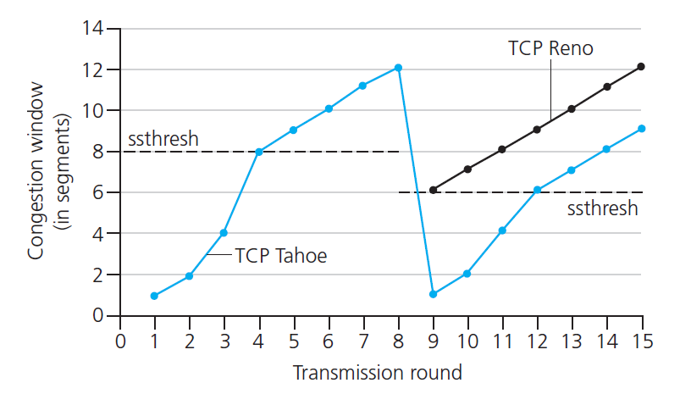
COMPUTER NETWORKS
TCP: switching from slow start to CA
Q: when should the exponential increase switch to linear?
A: when cwnd gets to 1/2 of its value before timeout.
Implementation:
variable ssthresh
on loss event, ssthresh is set to 1/2 of cwnd just before loss event

Slide 10


COMPUTER NETWORKS
Summary: TCP Congestion Control
New
ACK!
New
ACK!
.
duplicate ACK
new ACK
dupACKcount++
new ACK
cwnd = cwnd + MSS (MSS/cwnd)
dupACKcount = 0
transmit new segment(s), as allowed
cwnd = cwnd+MSS
dupACKcount = 0
transmit new segment(s), as allowed
Λ
cwnd = 1 MSS
ssthresh = 64 KB
dupACKcount = 0
cwnd > ssthresh
slow
start
Λ
congestion
avoidance
timeout
ssthresh = cwnd/2
cwnd = 1 MSS
dupACKcount = 0
retransmit missing segment
duplicate ACK
timeout
dupACKcount++
ssthresh = cwnd/2
cwnd = 1 MSS
dupACKcount = 0
retransmit missing segment
timeout
New
ACK!
ssthresh = cwnd/2
cwnd = 1
dupACKcount = 0
retransmit missing segment
New ACK
dupACKcount == 3
cwnd = ssthresh
dupACKcount = 0
dupACKcount == 3
ssthresh= cwnd/2
cwnd = ssthresh + 3
retransmit missing segment
ssthresh= cwnd/2
cwnd = ssthresh + 3
retransmit missing segment
fast
recovery
duplicate ACK
cwnd = cwnd + MSS
transmit new segment(s), as allowed

Slide 11
COMPUTER NETWORKS
TCP throughput
avg. TCP thruput as function of window size, RTT?
ignore slow start, assume always data to send
W: window size (measured in bytes) where loss occurs
avg. window size (# in-flight bytes) is ¾ W
avg. thruput is 3/4W per RTT
avg TCP thruput =
3
W
4
RTT
bytes/sec
W
W/2

Slide 12
COMPUTER NETWORKS
TCP Futures: TCP over “long, fat pipes”
example: 1500 byte segments, 100ms RTT, want 10 Gbps throughput
requires W = 83,333 in-flight segments
throughput in terms of segment loss probability, L [Mathis 1997]:
➜ to achieve 10 Gbps throughput, need a loss rate of L = 2·10⁻¹⁰ – a very small loss rate!
new versions of TCP for high-speed
1.22
.
MSS
TCP throughput =
RTT
L

Slide 13
COMPUTER NETWORKS
TCP Fairness
fairness goal: if K TCP sessions share same bottleneck link of bandwidth R, each should have average rate of R/K
TCP connection 1
bottleneck
router
capacity R
TCP connection 2

Slide 14
COMPUTER NETWORKS
Why is TCP fair?
two competing sessions:
additive increase gives slope of 1, as throughout increases
multiplicative decrease decreases throughput proportionally
R
equal bandwidth share
loss: decrease window by factor of 2
congestion avoidance: additive increase
Connection 2 throughput
loss: decrease window by factor of 2
congestion avoidance: additive increase
Connection 1 throughput
R

Slide 15
COMPUTER NETWORKS
Fairness (more)
Fairness and UDP
multimedia apps often do not use TCP
do not want rate throttled by congestion control
instead use UDP:
send audio/video at constant rate, tolerate packet loss
Fairness, parallel TCP connections
application can open multiple parallel connections between two hosts
web browsers do this
e.g., link of rate R with 9 existing connections:
new app asks for 1 TCP, gets rate R/10
new app asks for 11 TCPs, gets R/2

Slide 16
COMPUTER NETWORKS
Explicit Congestion Notification (ECN)
network-assisted congestion control:
two bits in IP header (ToS field) marked by network router to indicate congestion
congestion indication carried to receiving host
receiver (seeing congestion indication in IP datagram) ) sets ECE bit on receiver-to-sender ACK segment to notify sender of congestion
source
TCP ACK segment
destination
application
transport
network
link
physical
ECE=1
application
transport
network
link
physical
ECN=11
ECN=00
ECN=11
IP datagram

Slide 17
THANK YOU
Animesh Giri
Department of Computer Science & Engineering
animeshgiri@pes.edu
+91 80 6618 6603

